Slide 1
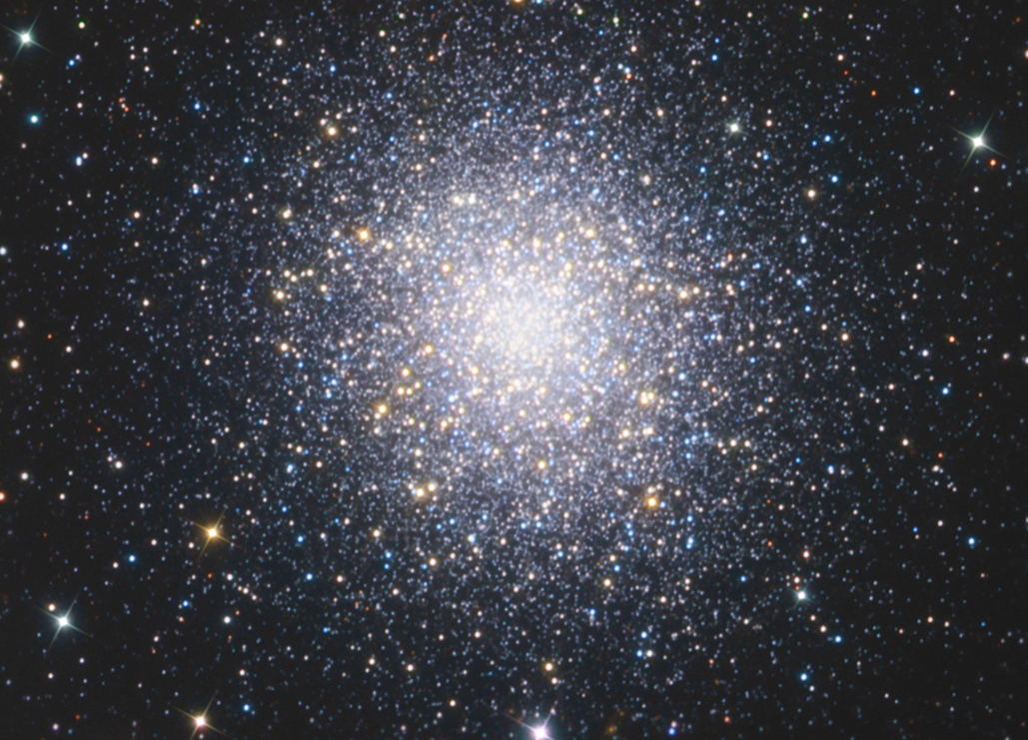
M92 Globular Cluster

Slide 2
A globular cluster is a spherical collection of stars that orbits
a galactic core as a satellite. Globular clusters are very tightly
bound by gravity, which gives them their spherical shapes
and relatively high stellar densities toward their centers.

Slide 3
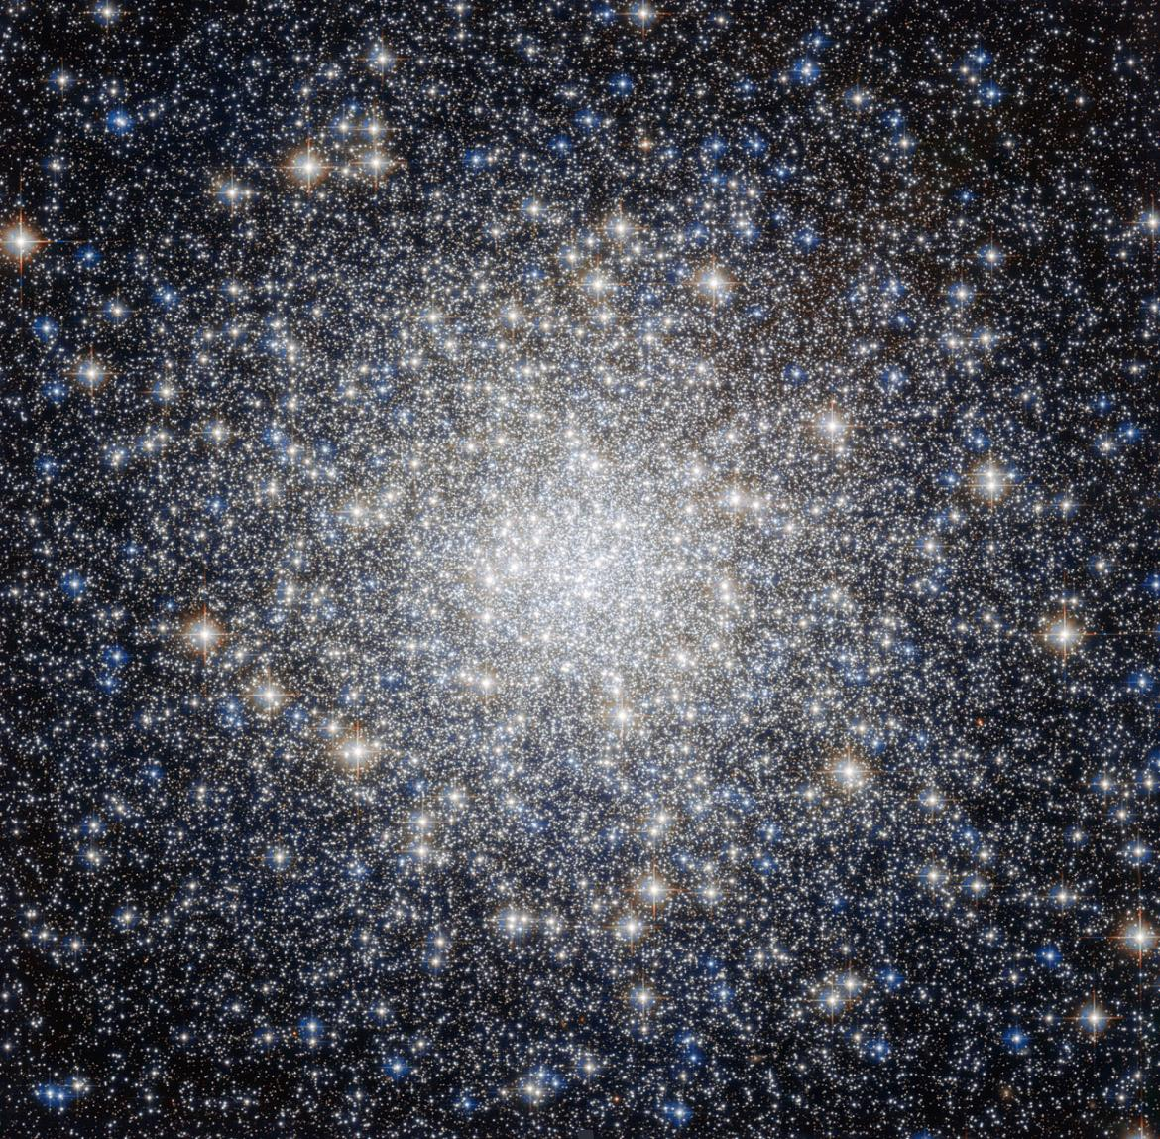
Constellation
 | 17h 17m 07.39s
 | +43° 08′ 09.4″
 | 26.7×10^3 ly (8.2 kpc)
Apparent magnitude (V) | +6.3
Apparent dimensions (V) | 14' arc minutes
Mass | 7005200000000000000♠2.0×105
 | [ Fe / H ] {\displaystyle {\begin{smallmatrix}\left[{\ce {Fe}}/{\ce {H}}\right]\end{smallmatrix}}} = –2.16
Estimated age | 14.2 ± 1.2 Gyr
Other designations | M92, NGC 6341, GCl 59

Slide 4
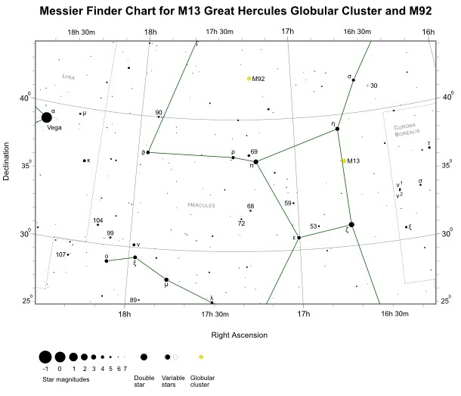

Slide 5
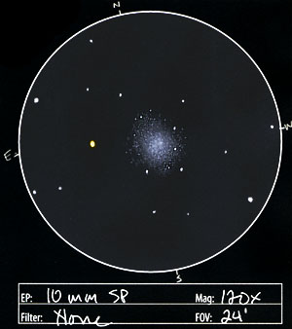
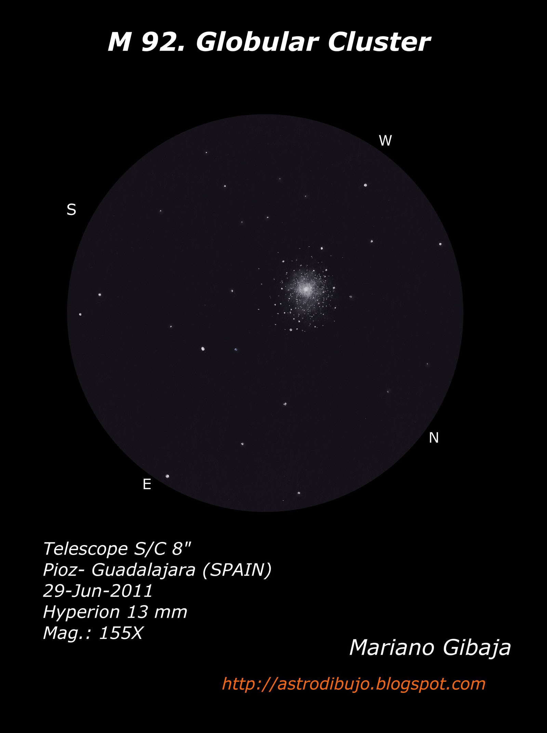

Slide 6
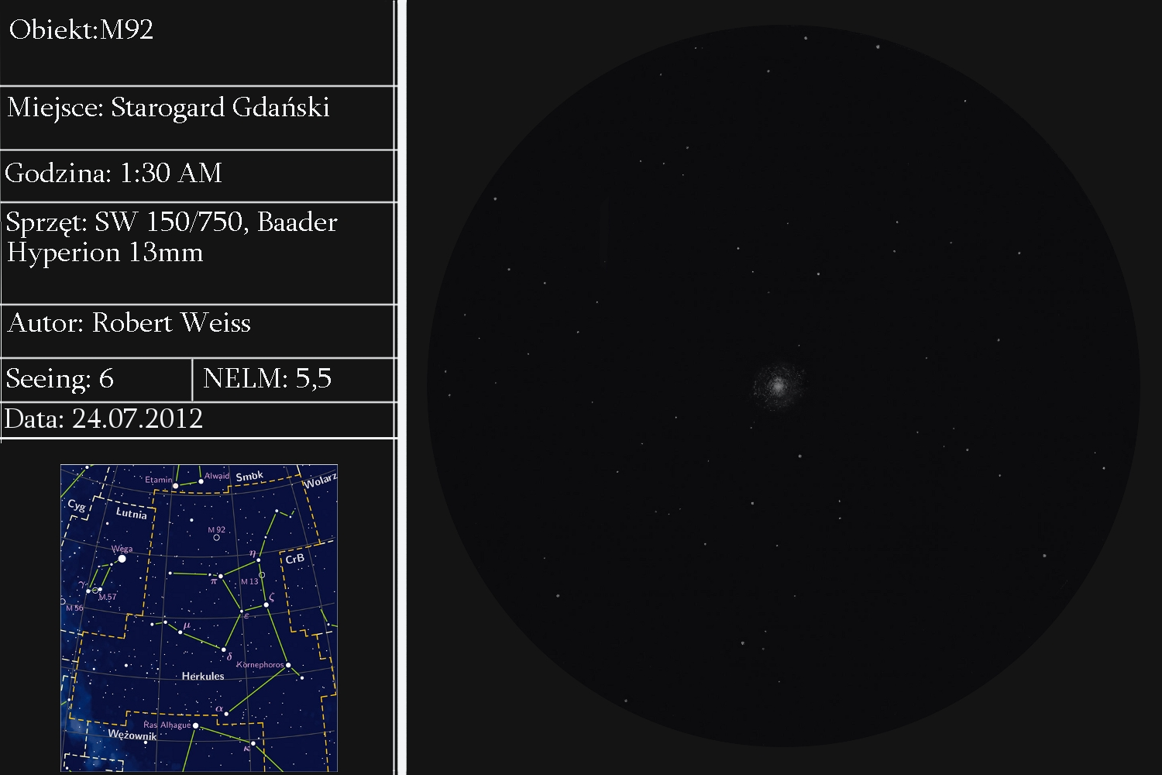

Slide 7
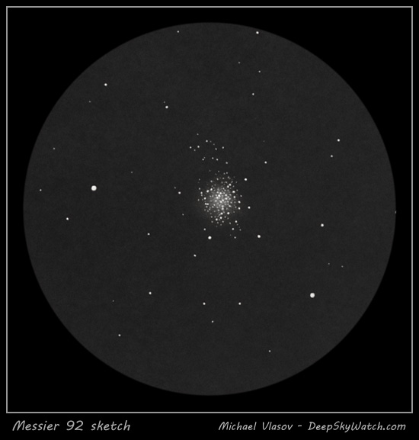
M92 appears somewhat smaller than M13 and is more elongated.

Slide 8
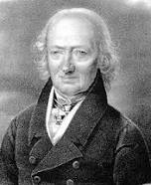
M92 is one of the original discoveries of Johann Elert Bode, who found it on December 27, 1777. Charles Messier independently rediscovered it and cataloged it on March 18, 1781, the same day as he cataloged another 8 objects, all of them Virgo Cluster galaxies (M84-M91). It was William Herschel who first resolved it into stars in 1783.
Johann Elert Bode was a German astronomer known for his reformulation and popularization of the Titius–Bode law. Bode determined the orbit of Uranus and suggested the planet's name.

